Slide 1
Customer Satisfaction -Decision Tree
Ishani shah

Slide 2
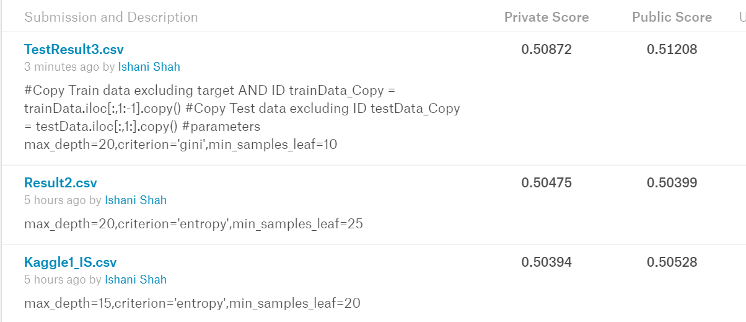
Decision Tree Models Comparison on Kaggle

Slide 3
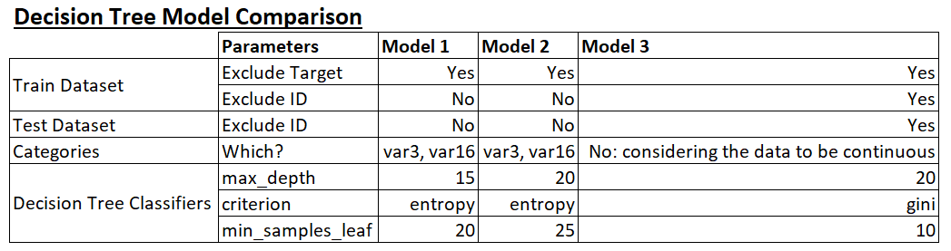
Models: Process Comparison on Excel

Slide 4
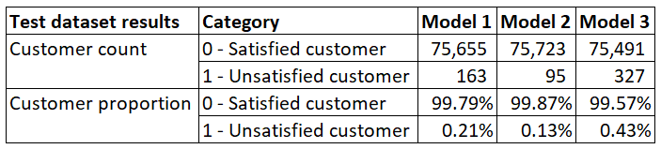
Test dataset Results Comparison

Slide 5
Why is this problem difficult from ML point of view?
There’s no data dictionary provided for the dataset. Hence, the solution/model can’t be tweaked without any domain knowledge.
Biased dataset: Out of 76k customers, 73k are satisfied customers and only 3k are unsatisfied. So, even if your accuracy is poor for the unsatisfied customer data, you would get a good overall accuracy of the model.

Slide 6
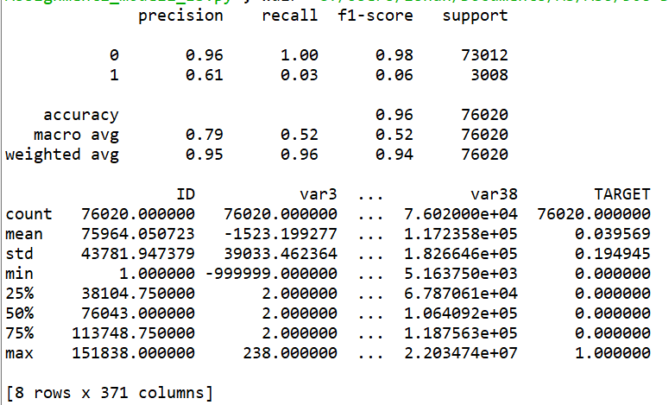
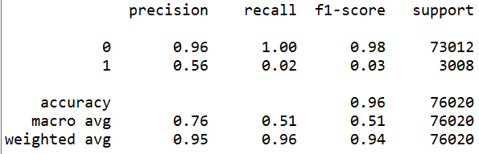
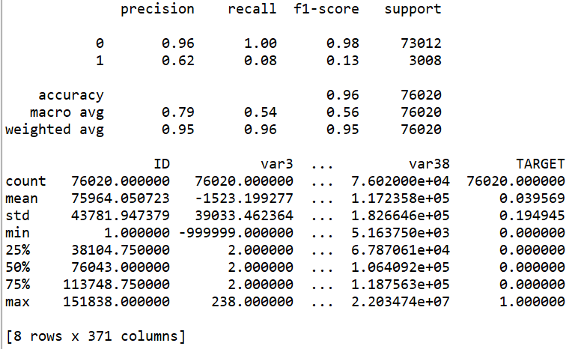
Classification Report Comparison: Train
Model 1
Model 2
Model 3

Slide 7
EDA on Train Dataset

